Slide 1
E-commerce Payment Company
By Eka N. Solicha

Slide 2
Client’s Conditions (Assumption)
E-commerce have high quantity of payment transactions per day
E-commerce need high speed of payment processing
E-commerce need a secure payment channel
E-commerce want to get as many successful transactions as possible
There are a lot of payment channels available such as credit card, debit, virtual account, e-wallet, etc.
There is a bank integrated with each payment channel, means many channels require integrations with many banks
Main Problem Statement
Clients need a tools to manage the multiple payment channel easier with comprehensive report feature

Slide 3
Business Impact
Solution
Create a simple web-based apps to manage the multiple payment channel
Create a feature to produce report for each channel and overview with different timeframe
Enable client to determine the most effective payment channel which could impact in lowering cost on maintaining too many channel
Increase user effectiveness in managing channel, thus more time effective than using manual channel management
Increase the revenue by letting client decide which channel has the most acceptance rate

Slide 4
Metrics
MVP
A dashboard for client to manage their payment channel and view report for each channel in a certain time frame
Future possible improvement:
Enable smart routing to each payment system to increase the likelihood of payment being approved by any bank integrated with the payment gateway
Number of transactions per day
Number of failed transactions
Acceptance rate (successful transactions/all transactions in percent)
Average transactions processing time

Slide 5
Simple Roadmap
Actor | Activity | Week 1-2 | Week 3-4 | Week 5-6 | Week 7-8
Product manager | Create PRD
Product manager | Create wireframe
UI/UX Designer | Create hi-fidelity mockup
Developer | Start develop
QA engineer | Testing
All | Sprint planning and sprint meeting
 | Product Launch

Slide 6
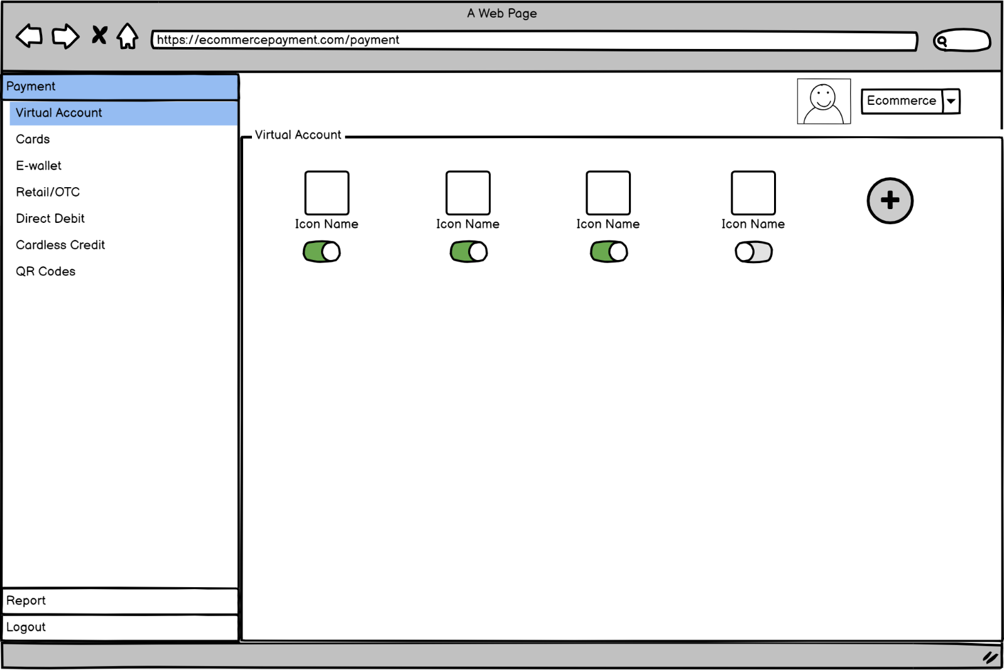
Wireframe (Payment Manager)
User Stories 1: User should be able to manage their payment channels

Slide 7
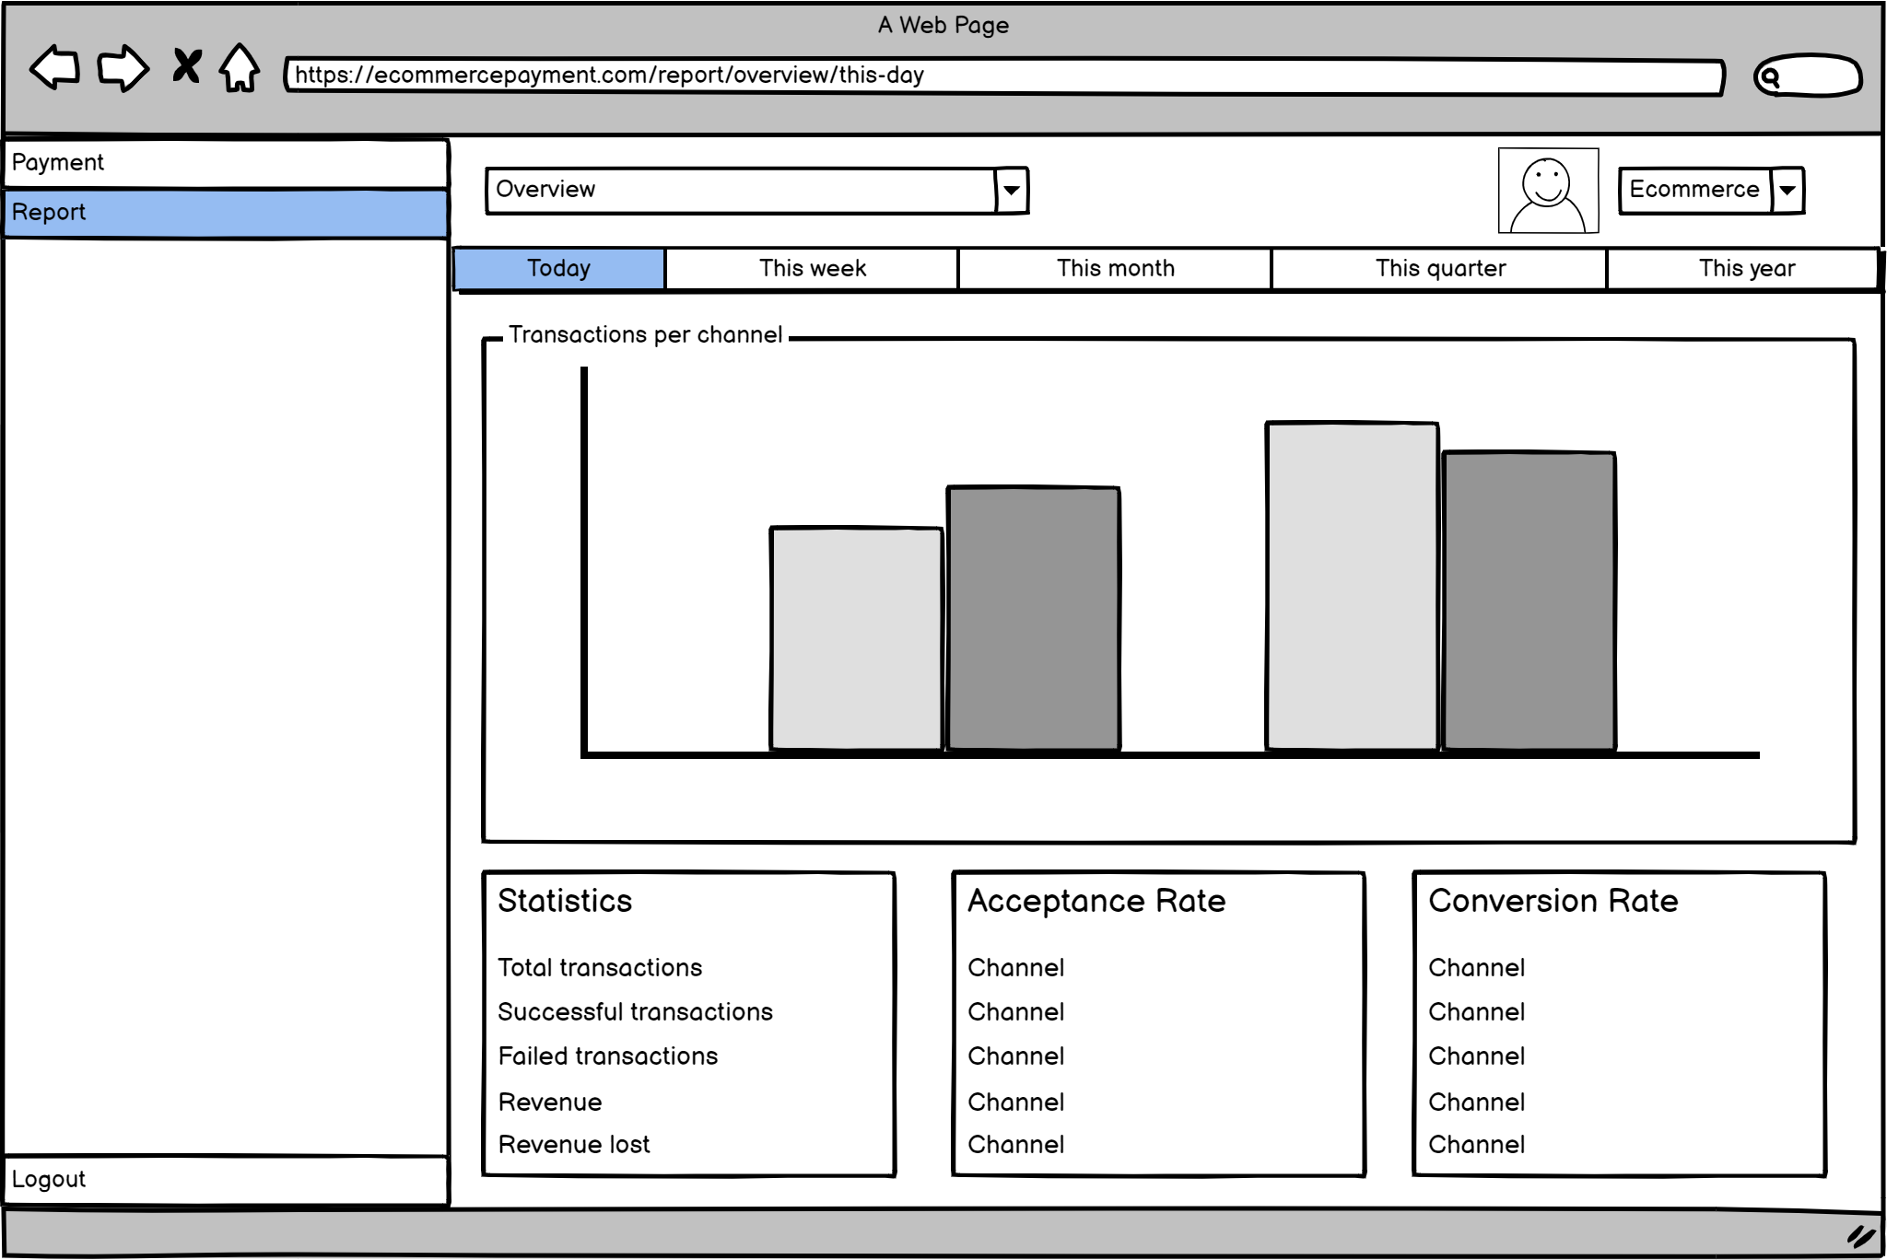
Wireframe (Report)
User Stories 2: User should be able to view the report both for overview all channel or specifically each channel in a certain time frame

Slide 8
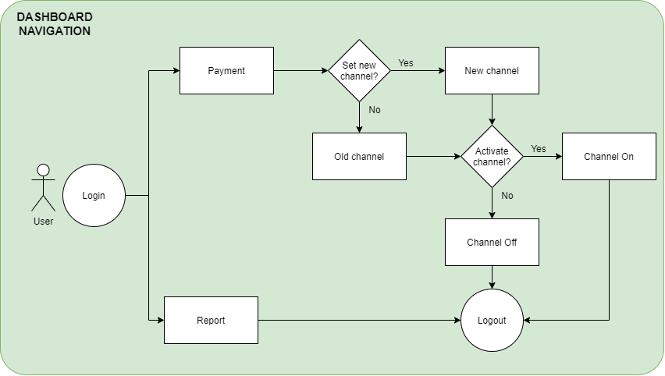
User Flow

Slide 9
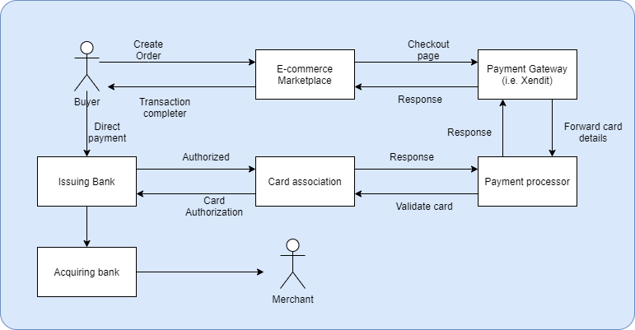
Payment Routing Flow

